Slide 1

Tempo de Retenção
Dados e Gráficos

Slide 2
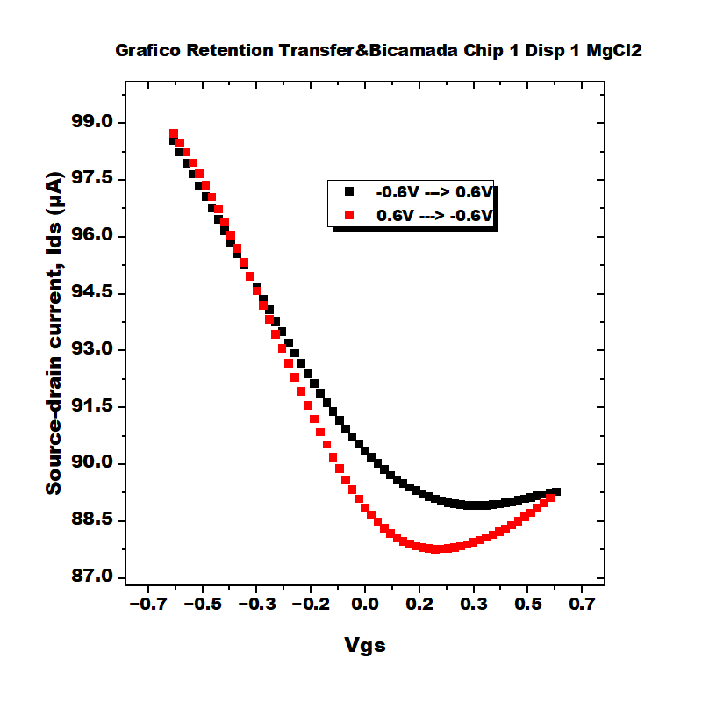
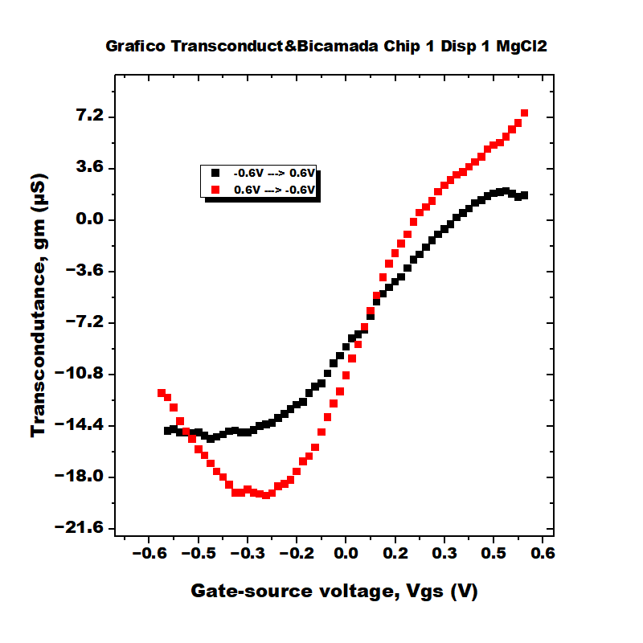
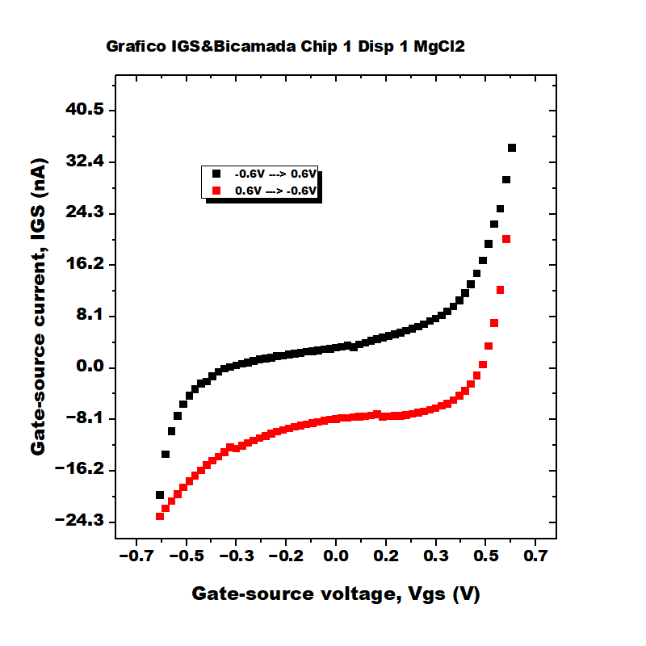
Bicamada Chip 1 Disp 1 MgCl2

Slide 3
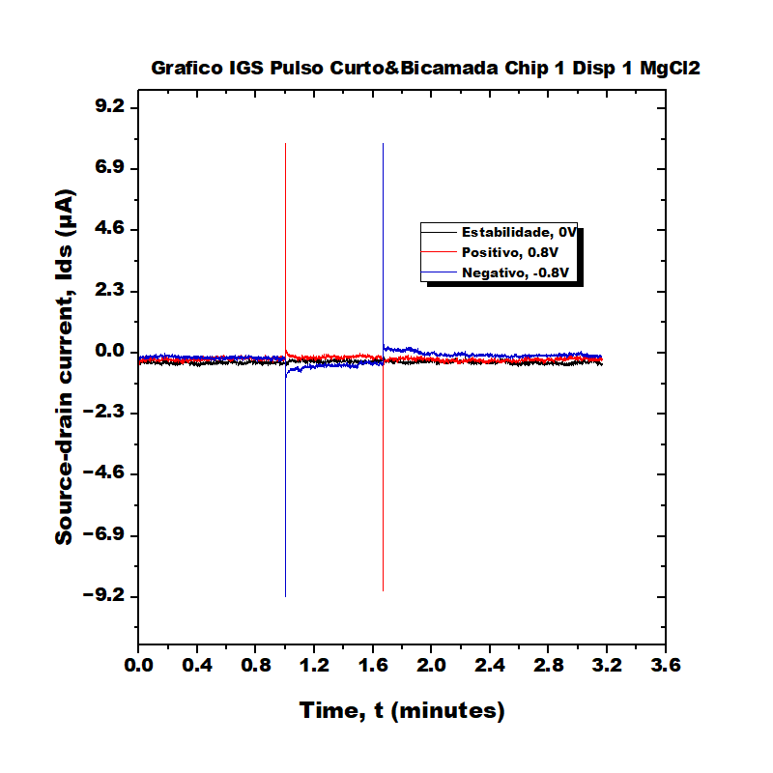
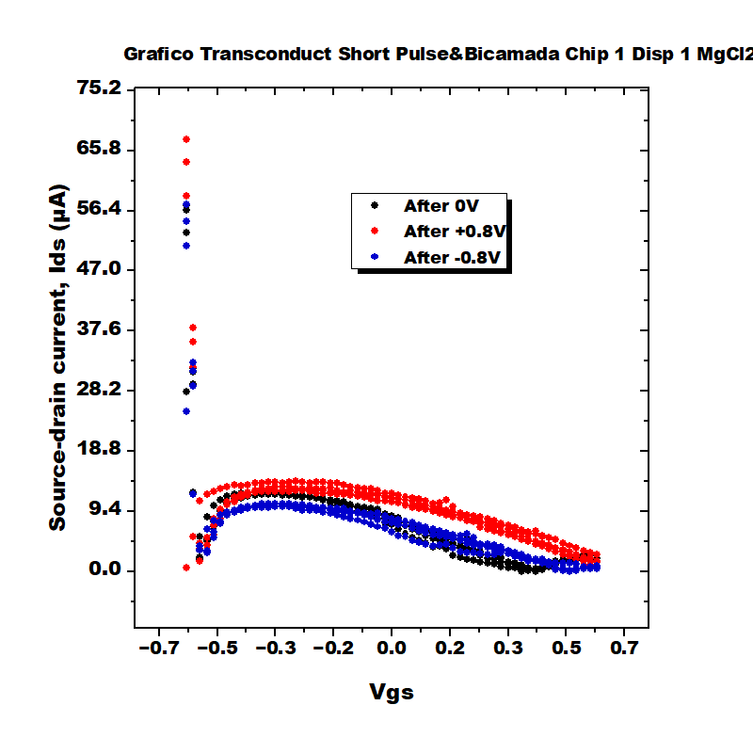
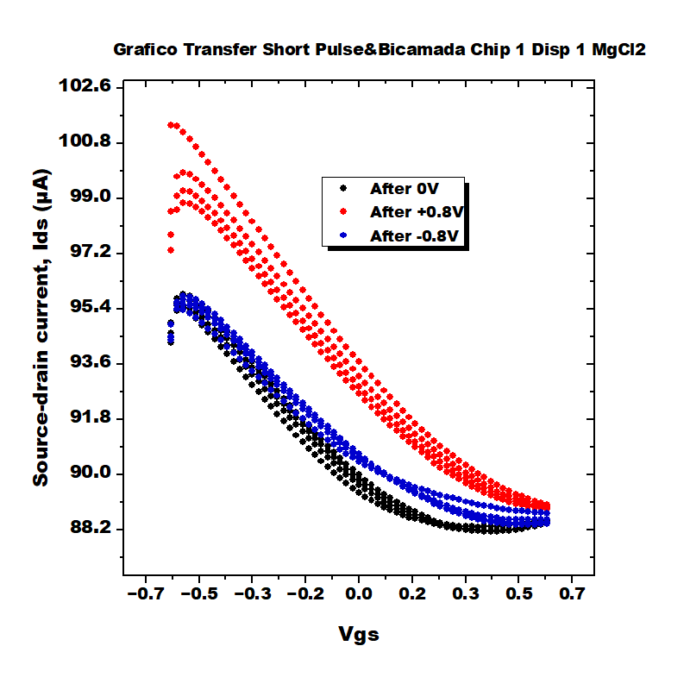
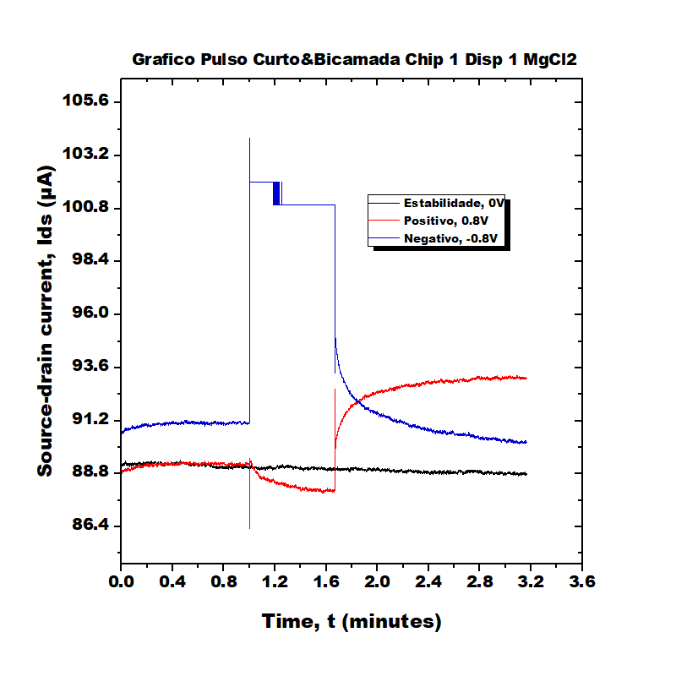
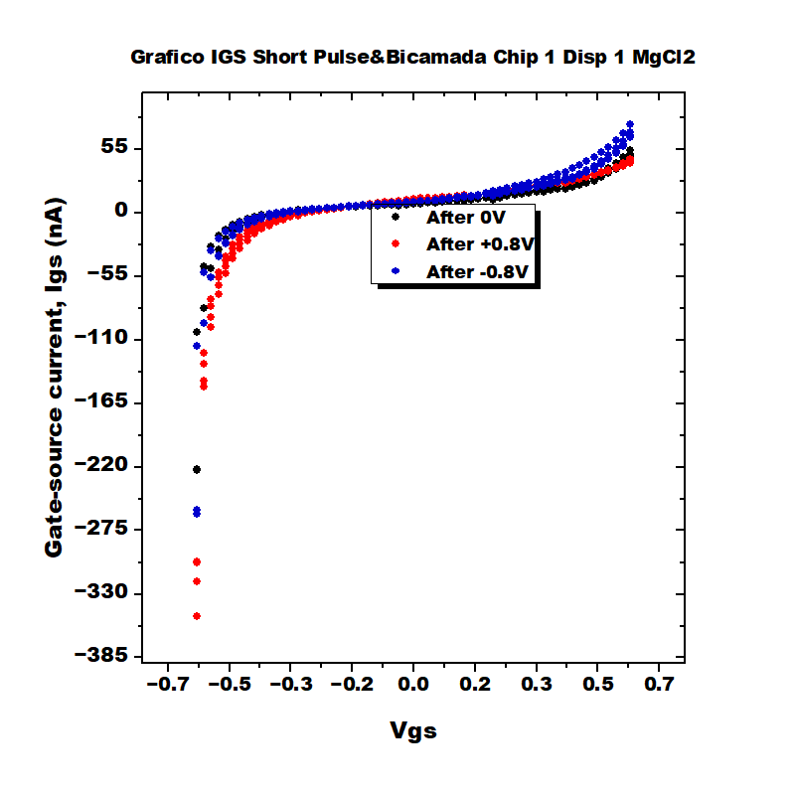
Bicamada Chip 1 Disp 1 MgCl2

Slide 4
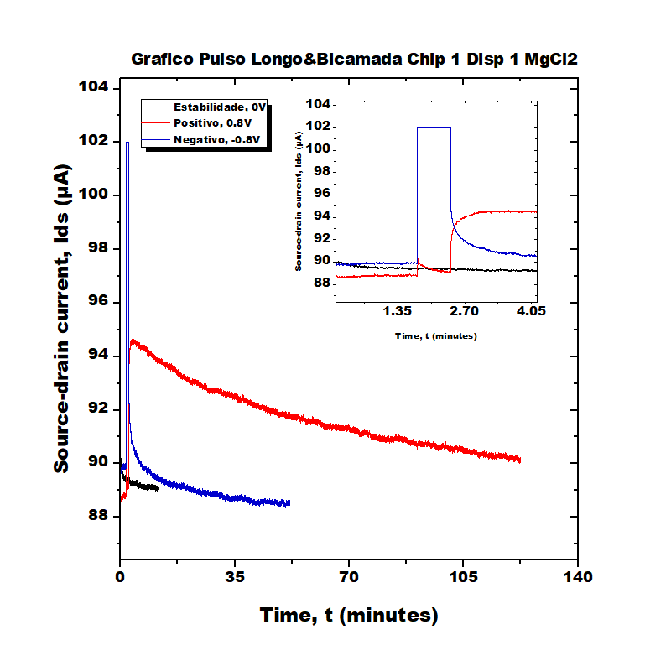
Bicamada Chip 1 Disp 1 MgCl2

Slide 5
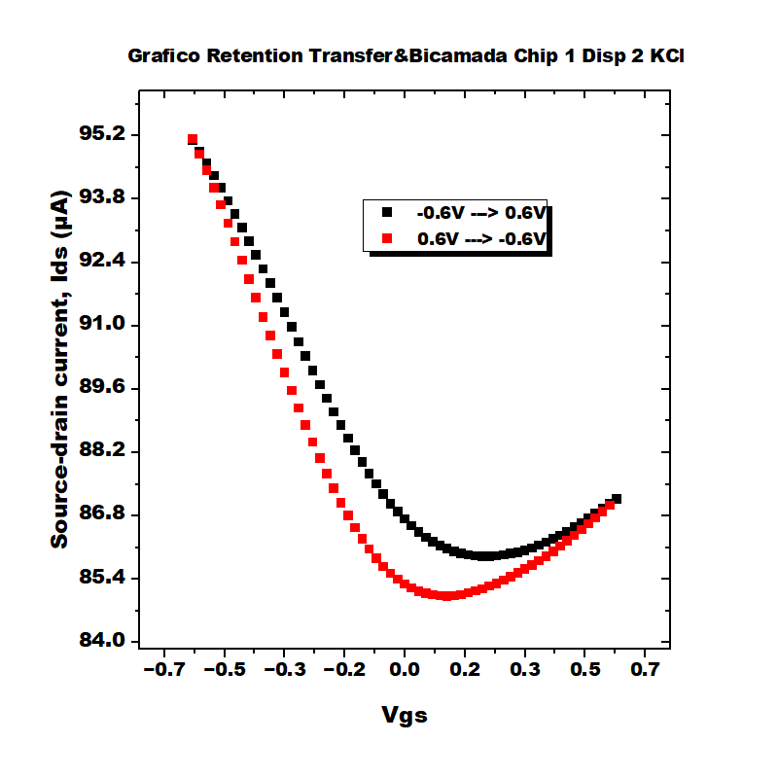
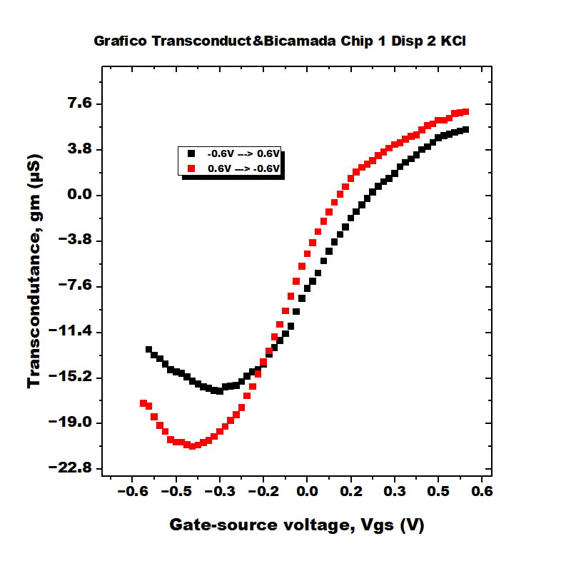
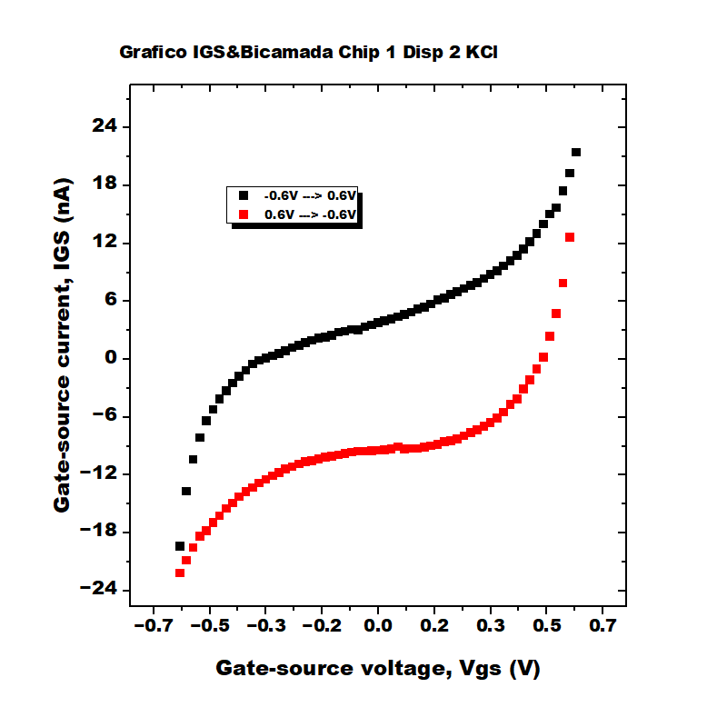
Bicamada Chip 1 Disp 2 KCl

Slide 6
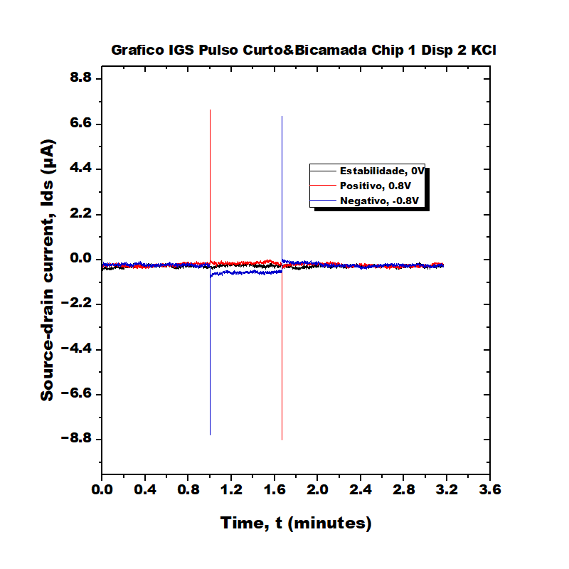
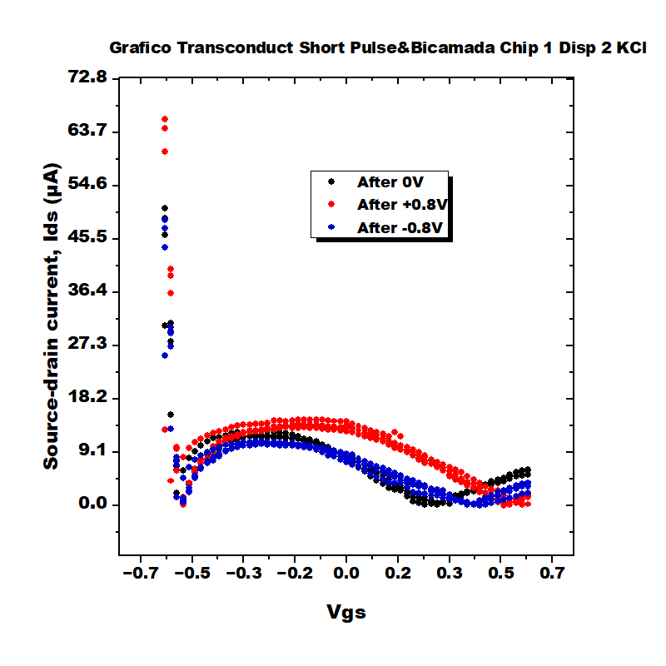
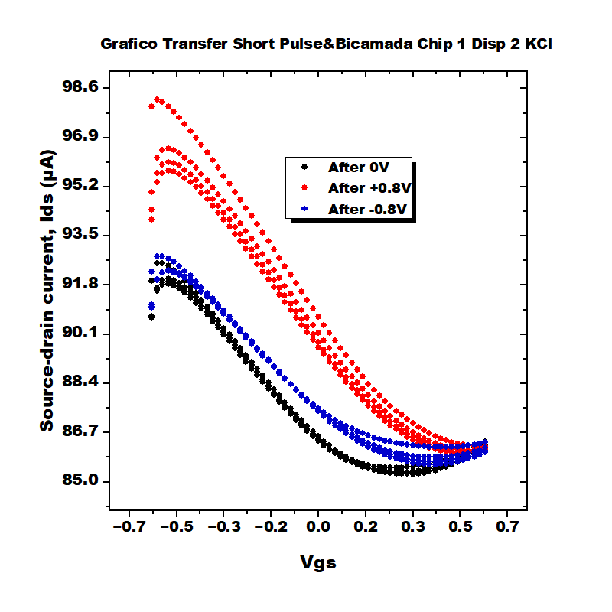
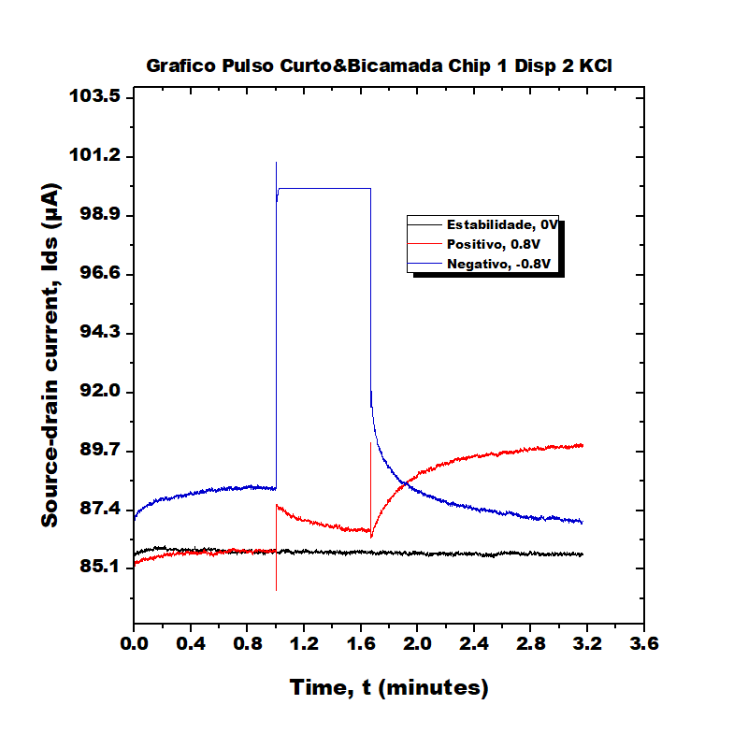
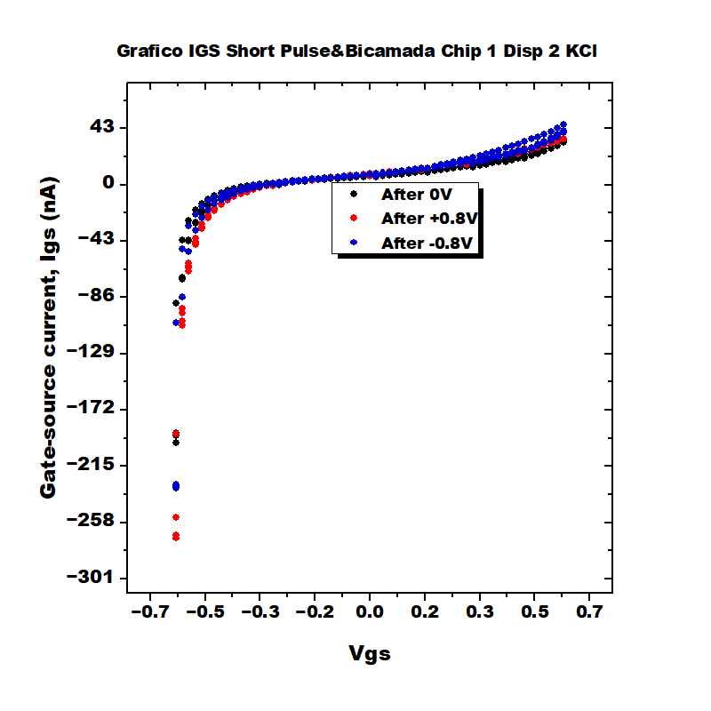
Bicamada Chip 1 Disp 2 KCl

Slide 7
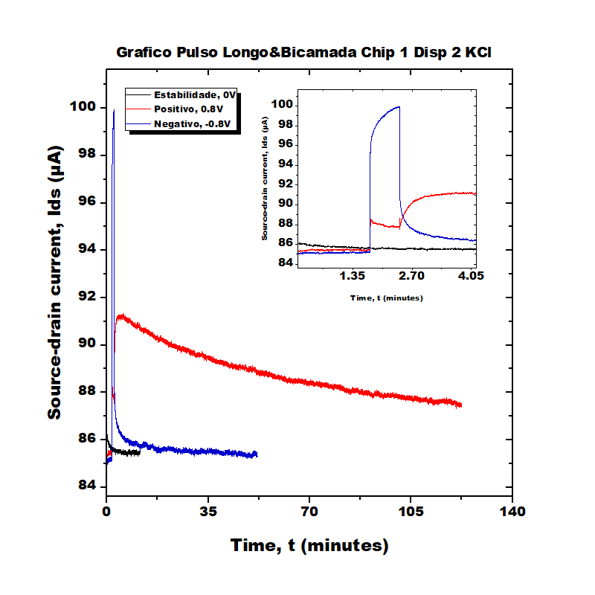
Bicamada Chip 1 Disp 2 KCl

Slide 8

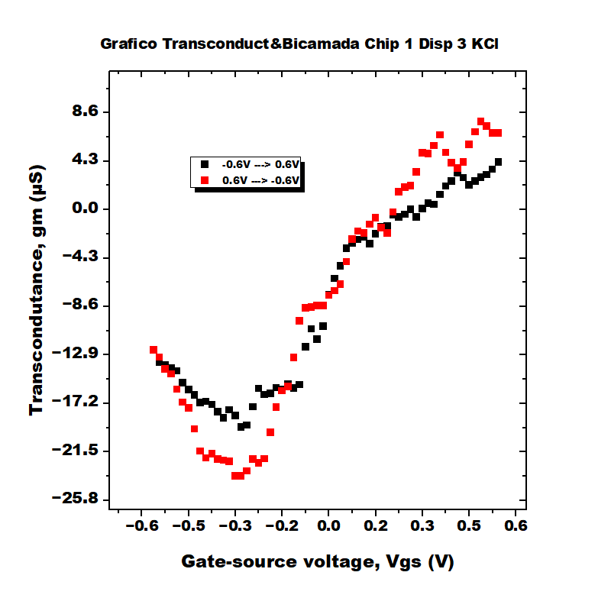
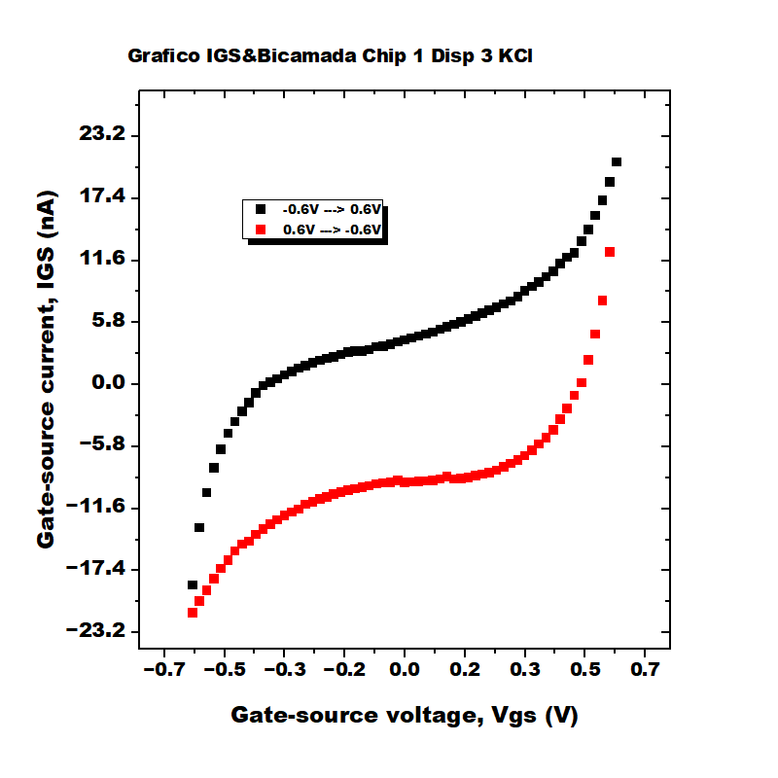
Bicamada Chip 1 Disp 3 KCl

Slide 9
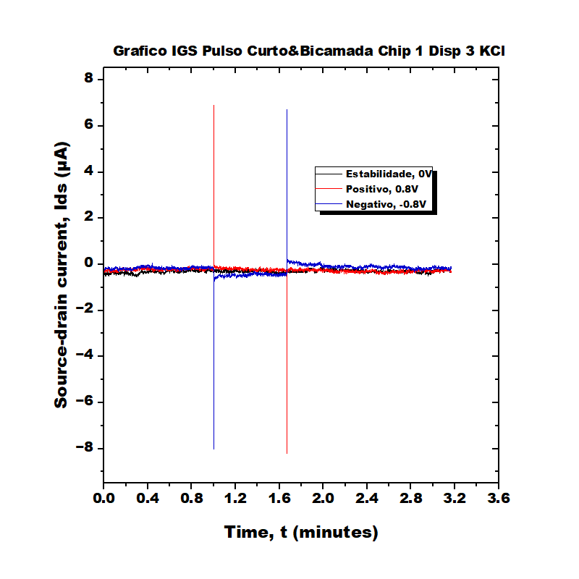
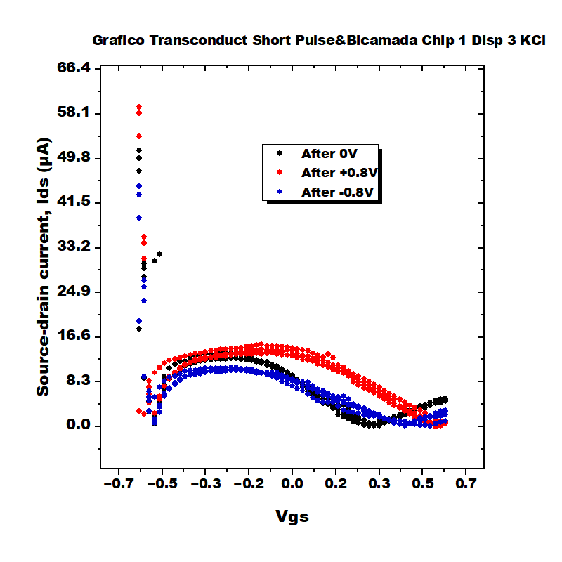
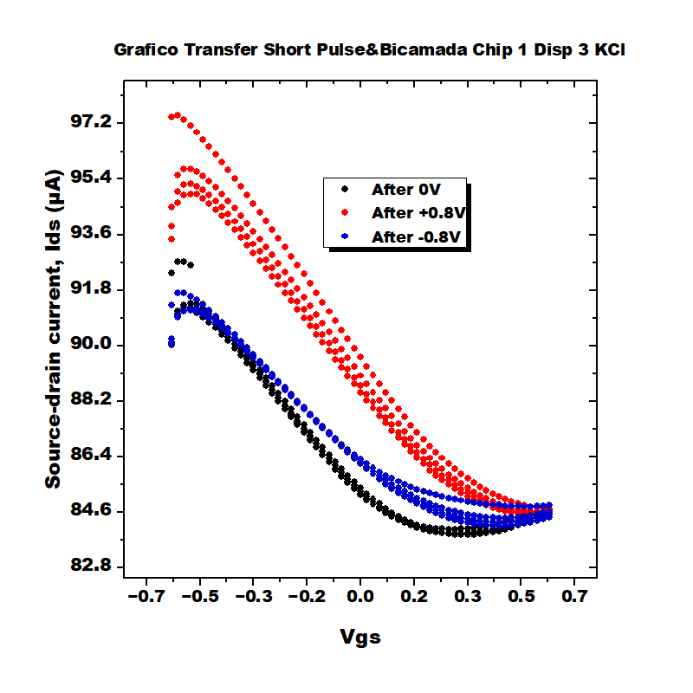
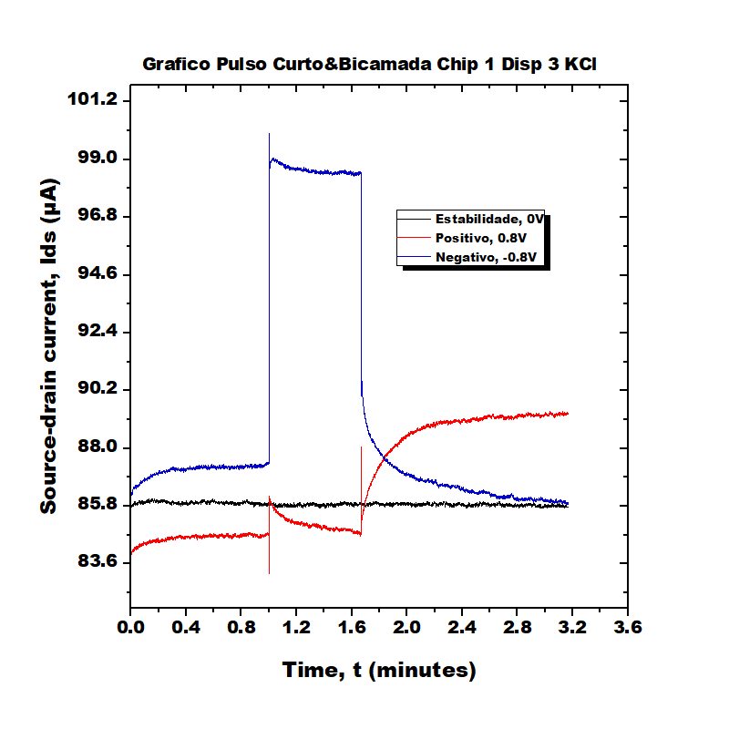
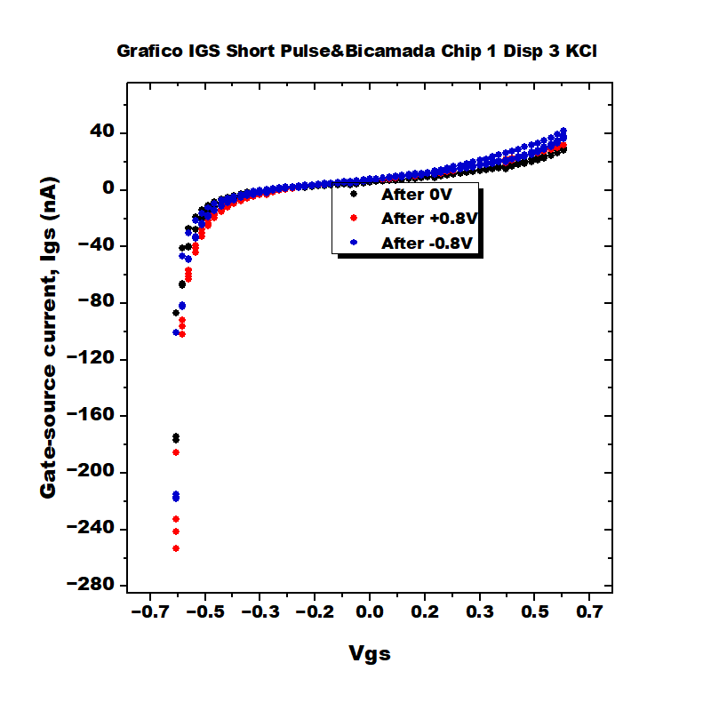
Bicamada Chip 1 Disp 3 KCl

Slide 10
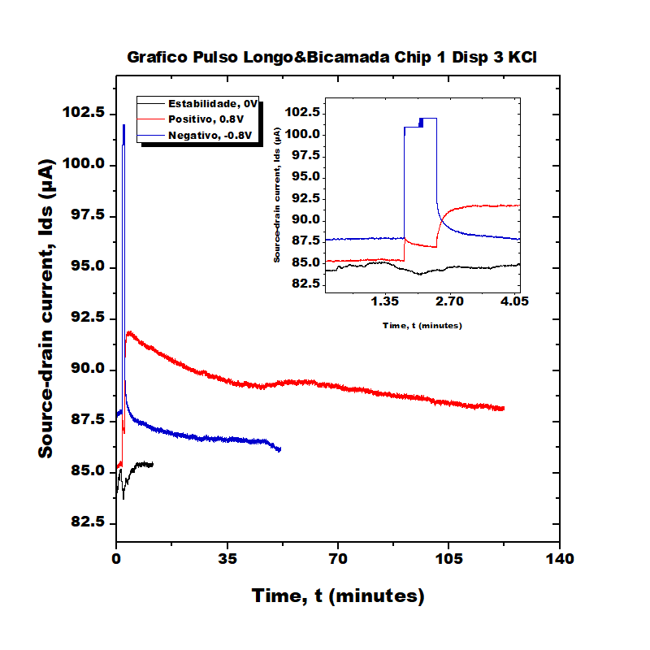
Bicamada Chip 1 Disp 3 KCl

Slide 11
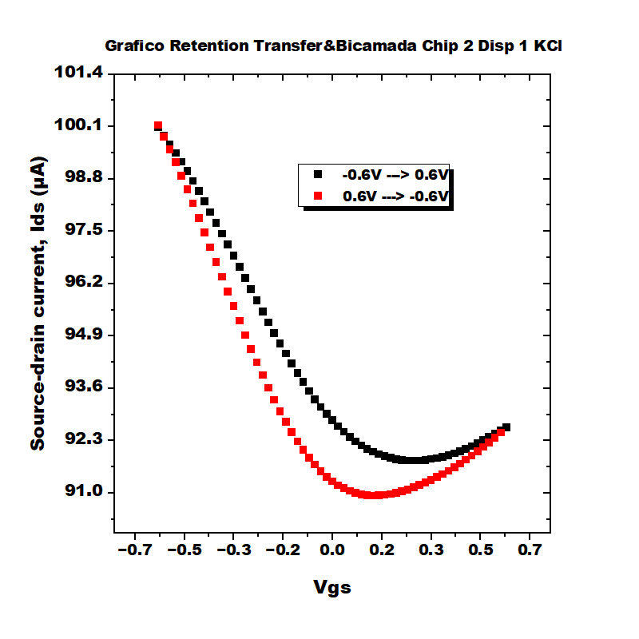
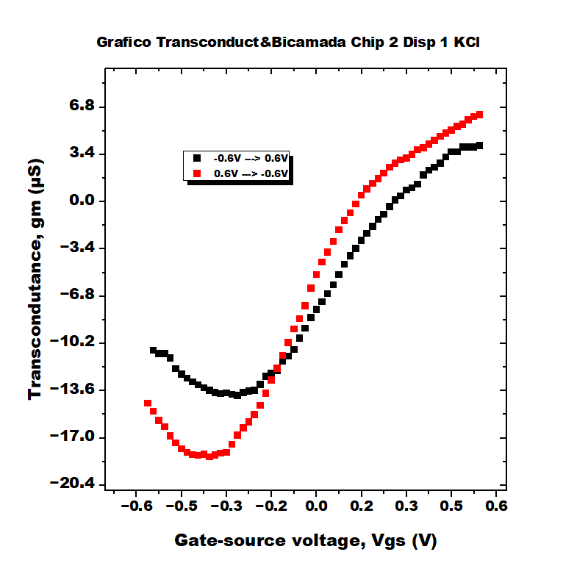
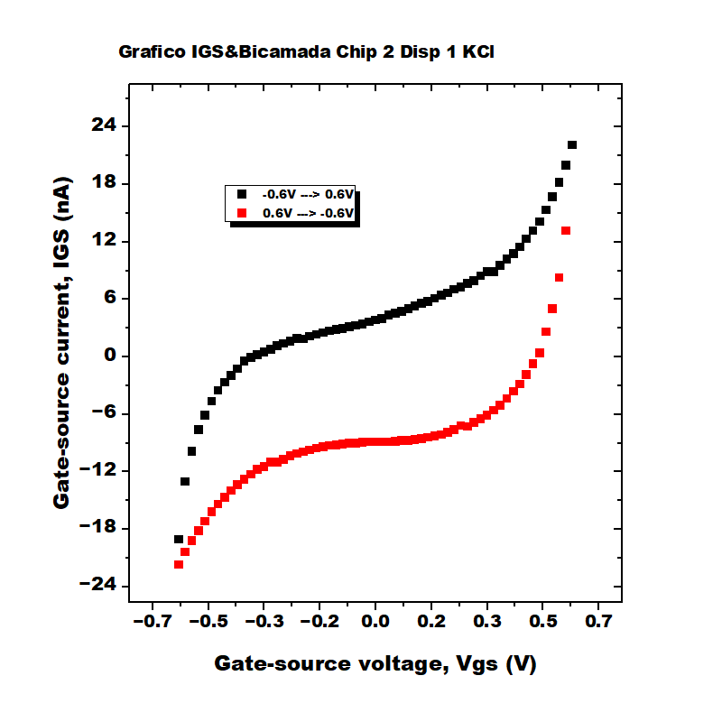
Bicamada Chip 2 Disp 1 KCl

Slide 12


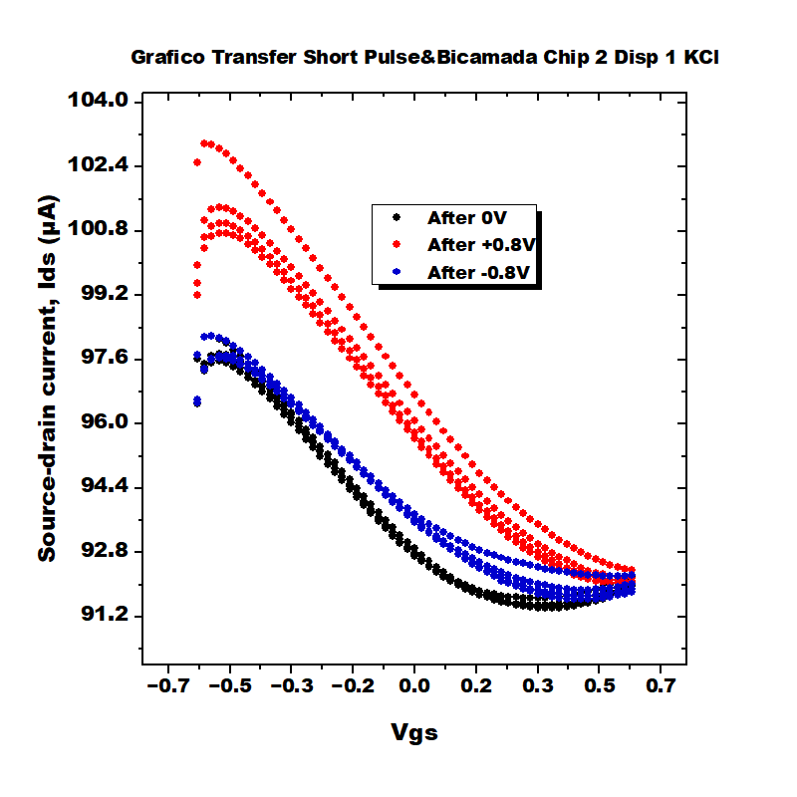
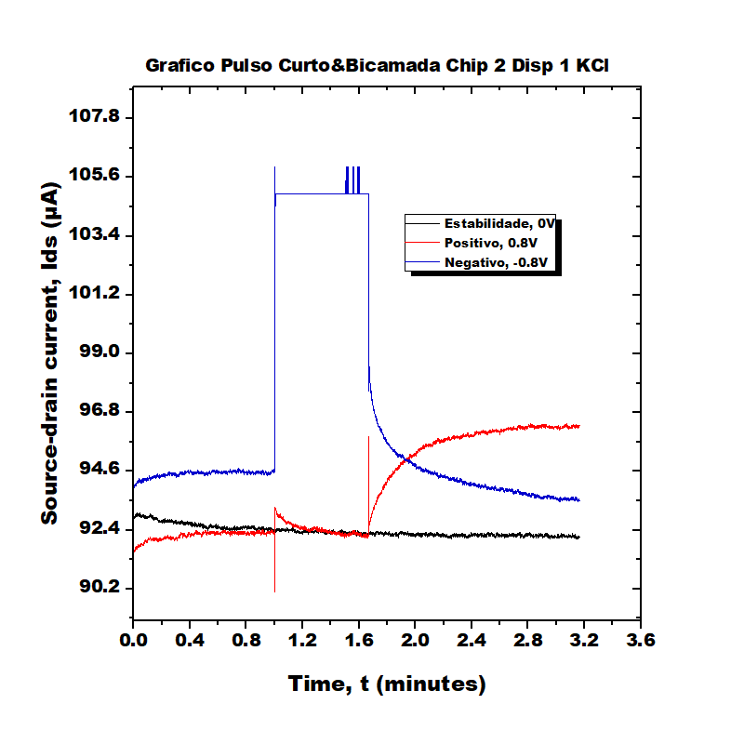
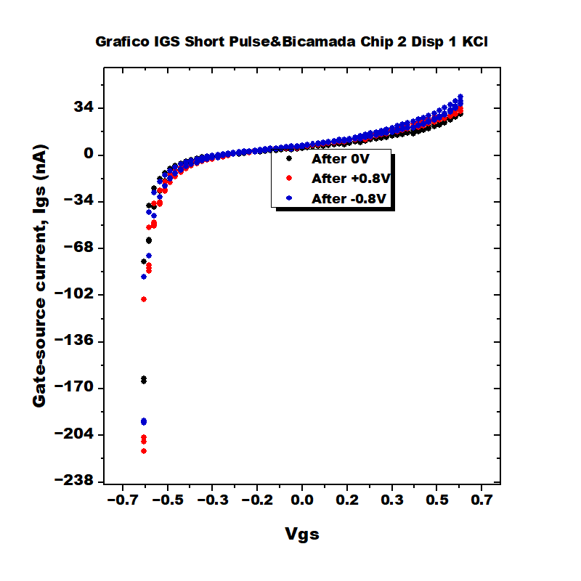
Bicamada Chip 2 Disp 1 KCl

Slide 13
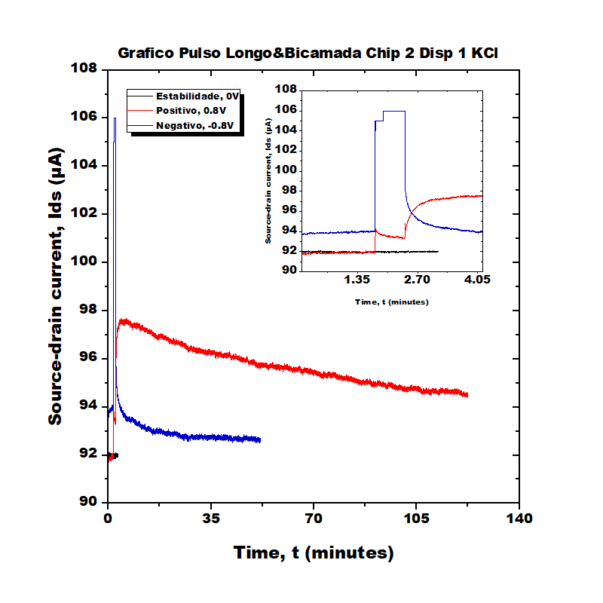
Bicamada Chip 2 Disp 1 KCl

Slide 14
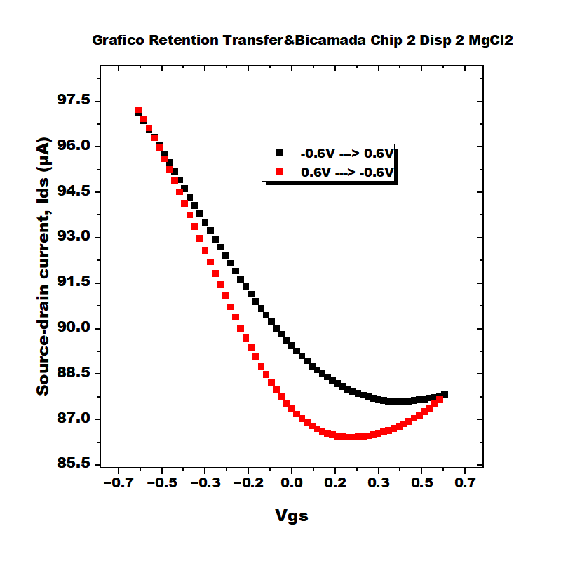
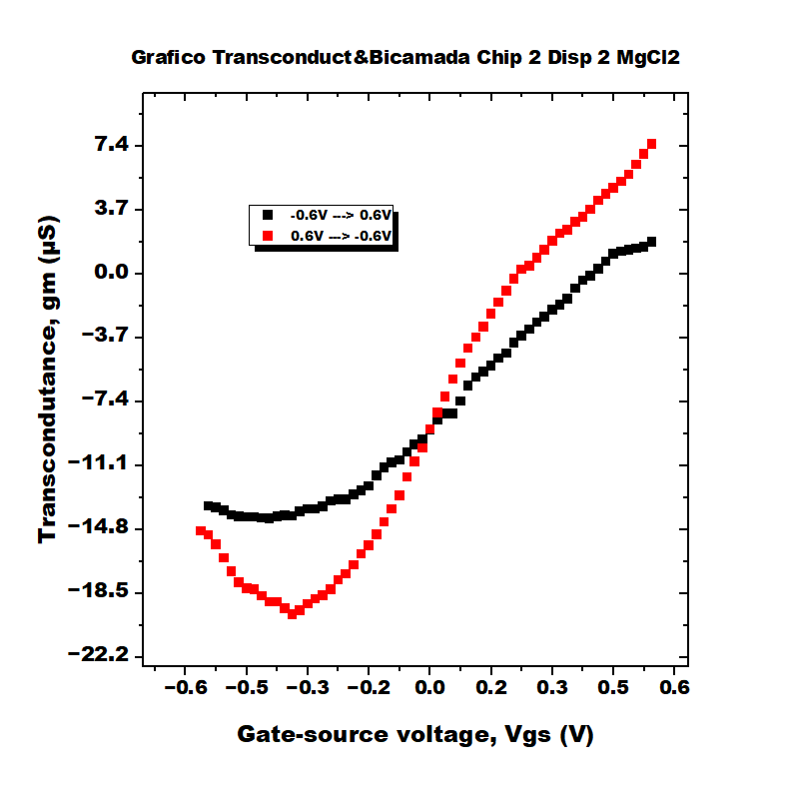
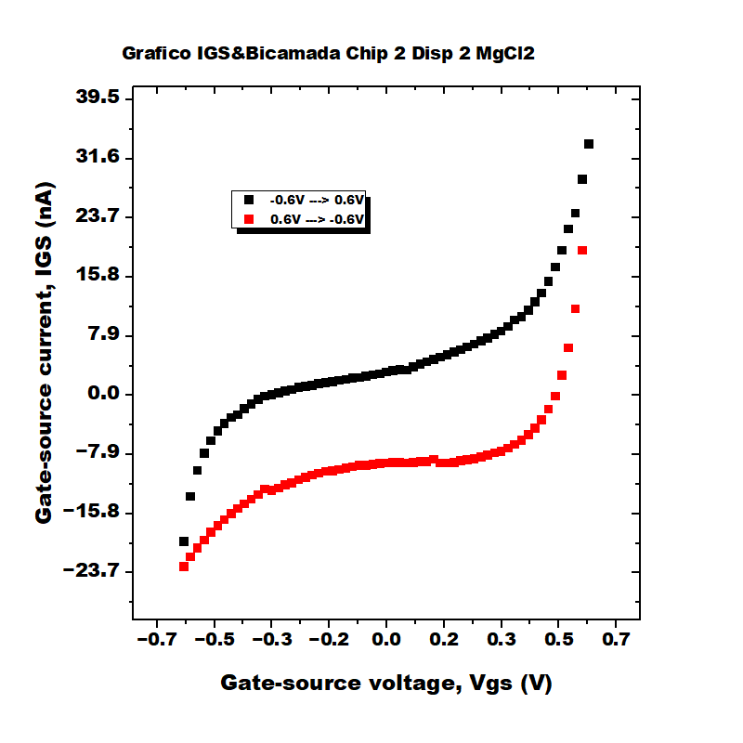
Bicamada Chip 2 Disp 2 MgCl2

Slide 15
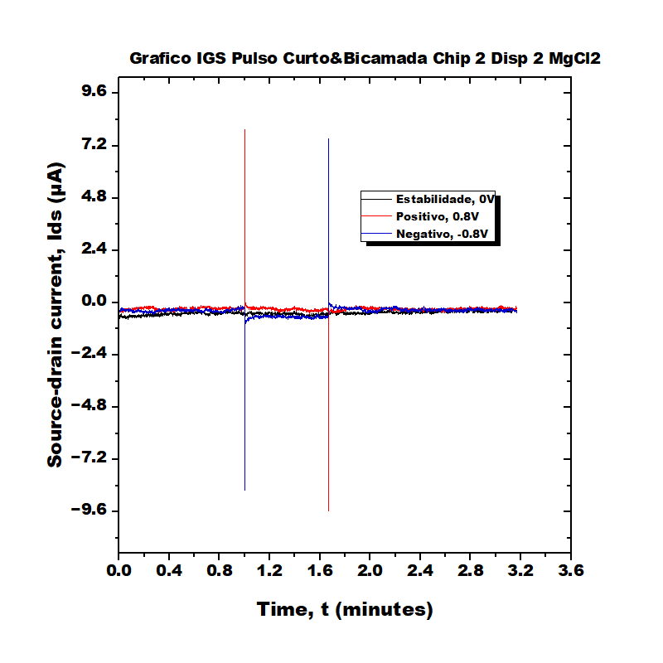
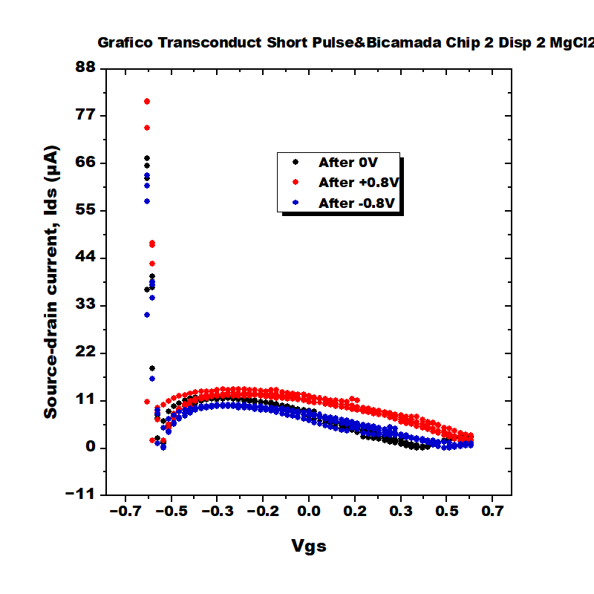
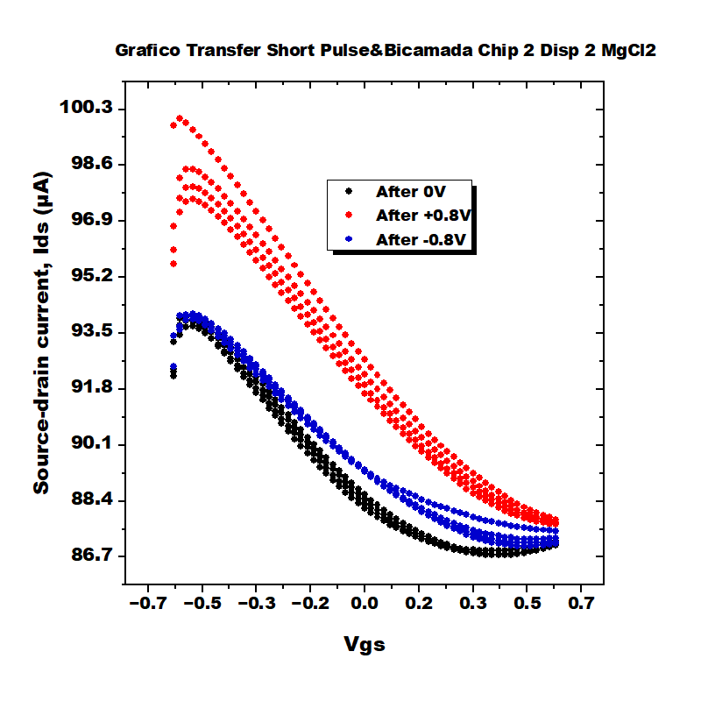
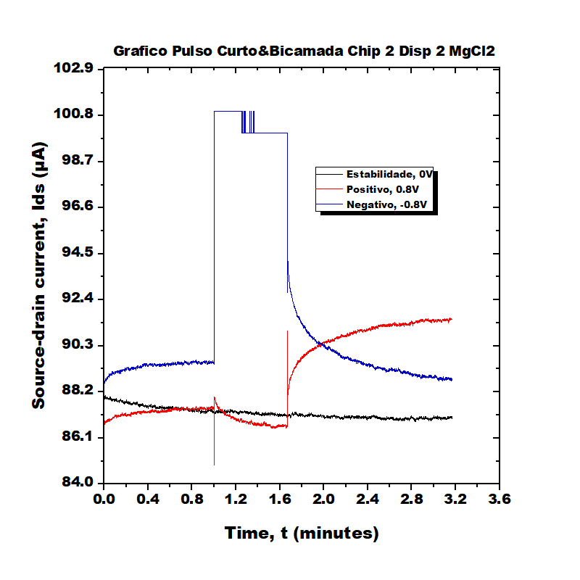

Bicamada Chip 2 Disp 2 MgCl2

Slide 16
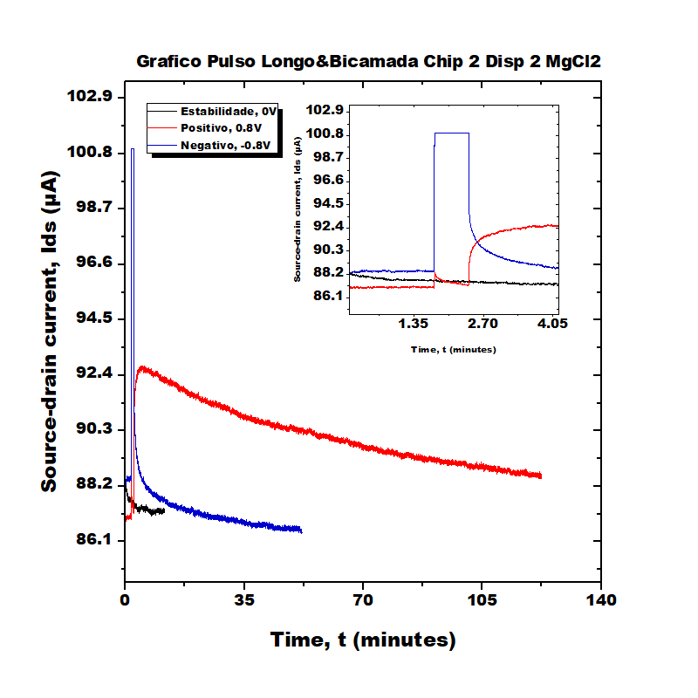
Bicamada Chip 2 Disp 2 MgCl2

Slide 17

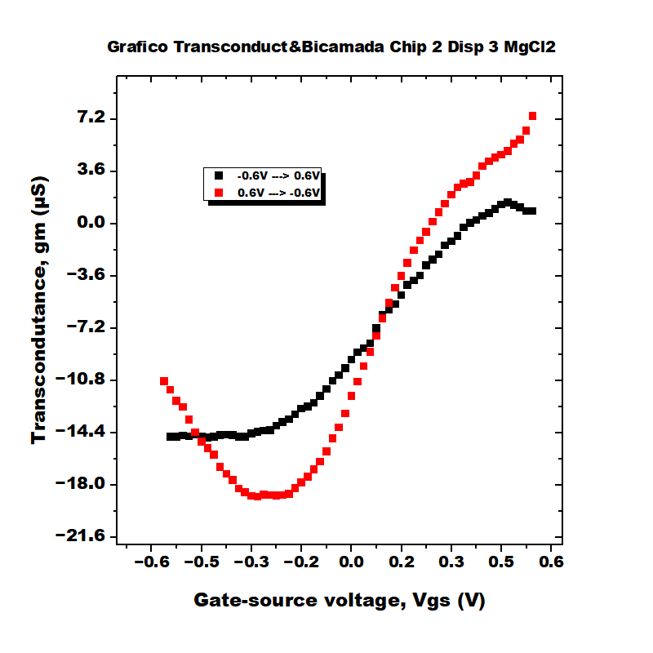

Bicamada Chip 2 Disp 3 MgCl2

Slide 18
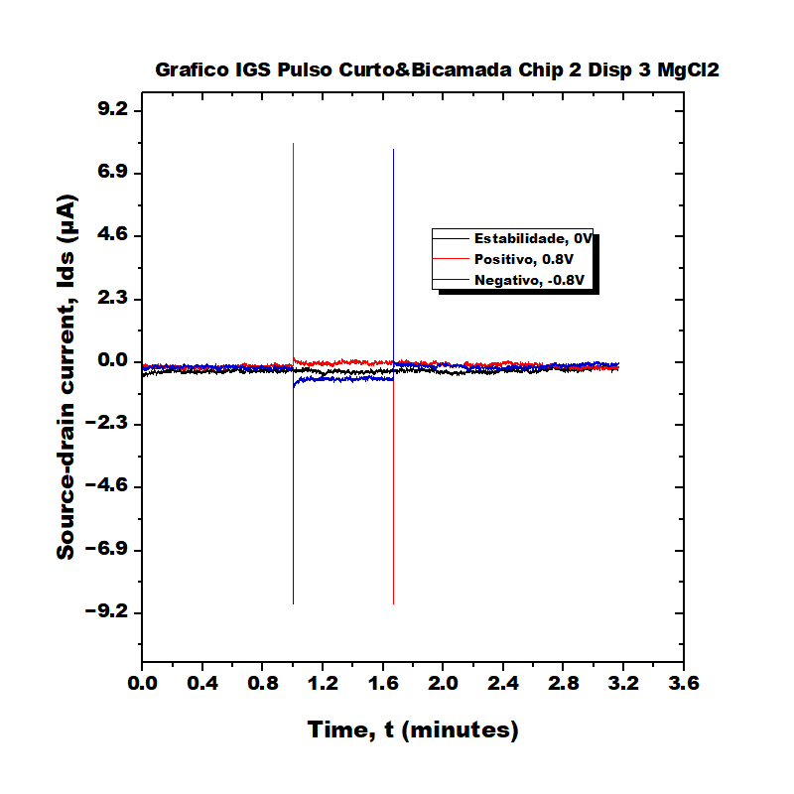

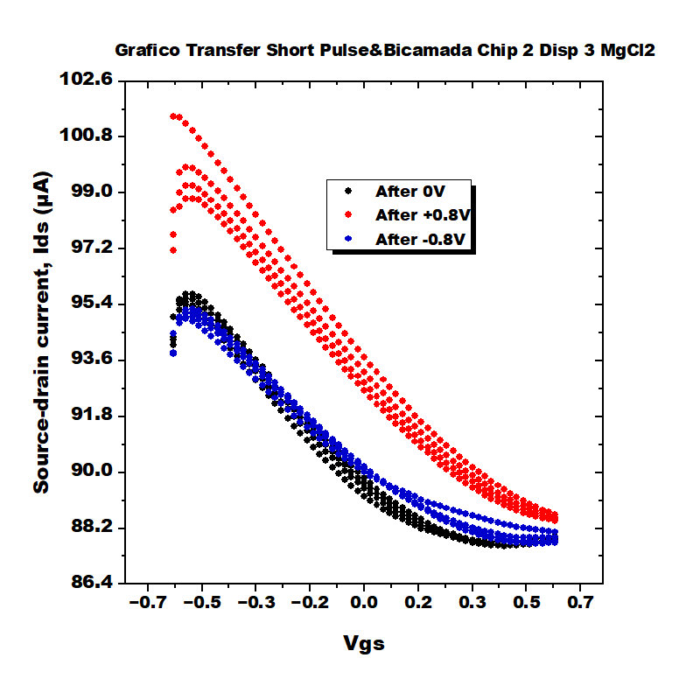
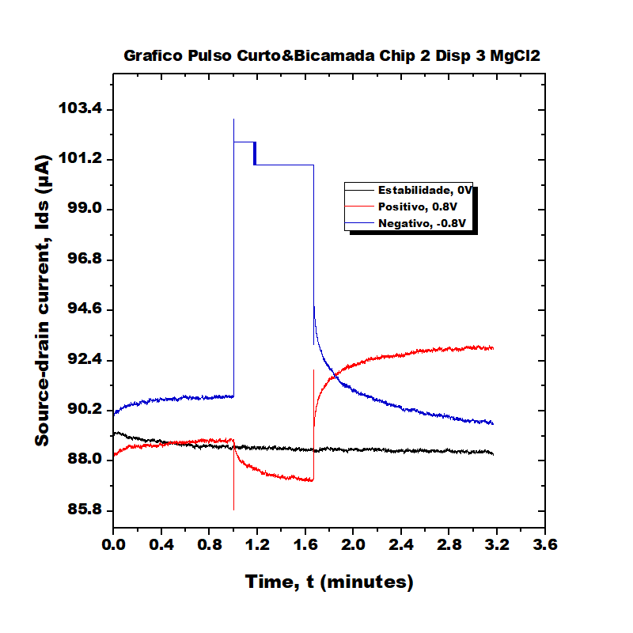

Bicamada Chip 2 Disp 3 MgCl2

Slide 19
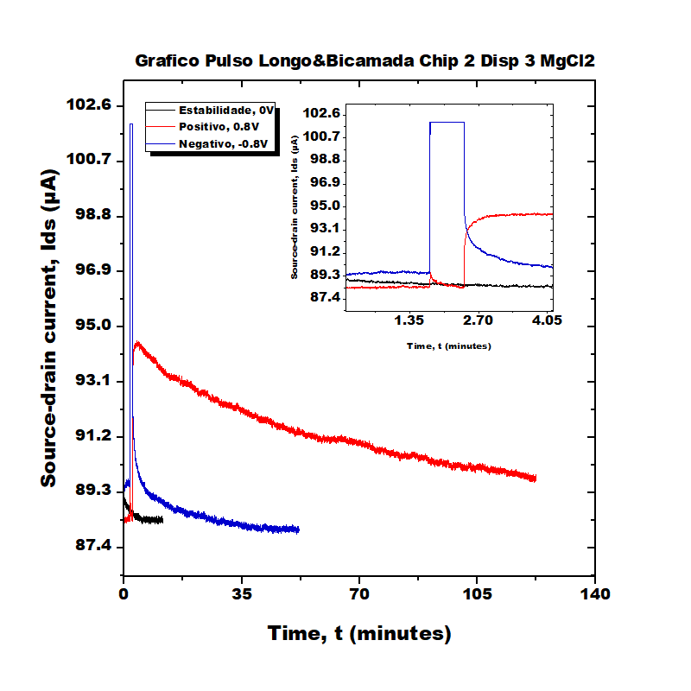
Bicamada Chip 2 Disp 3 MgCl2

Slide 20
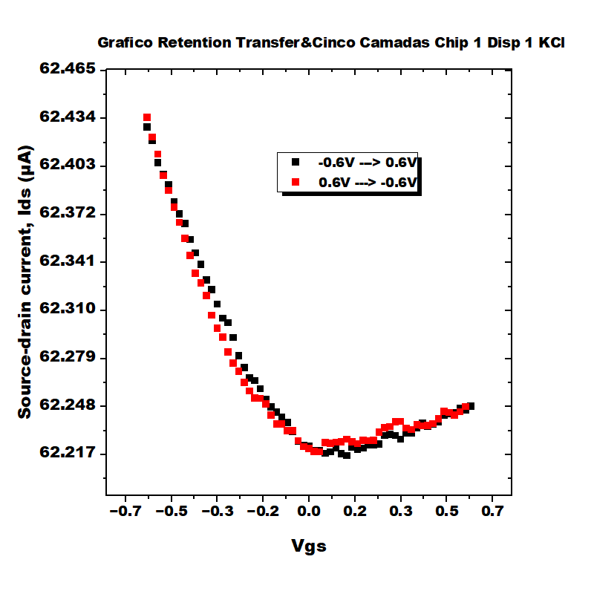
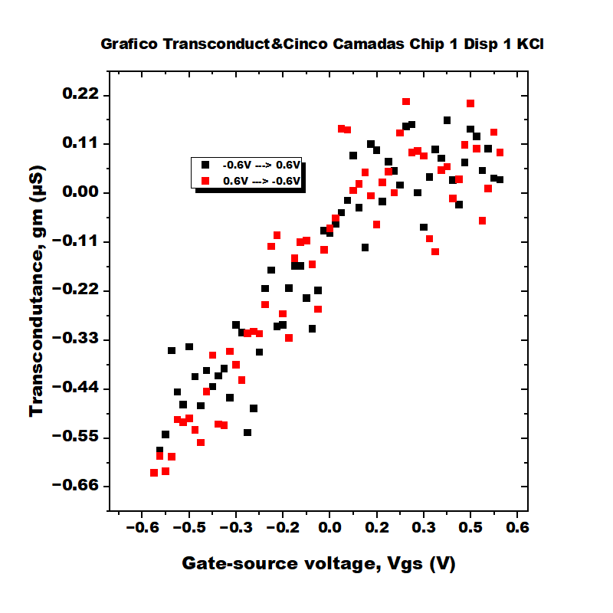
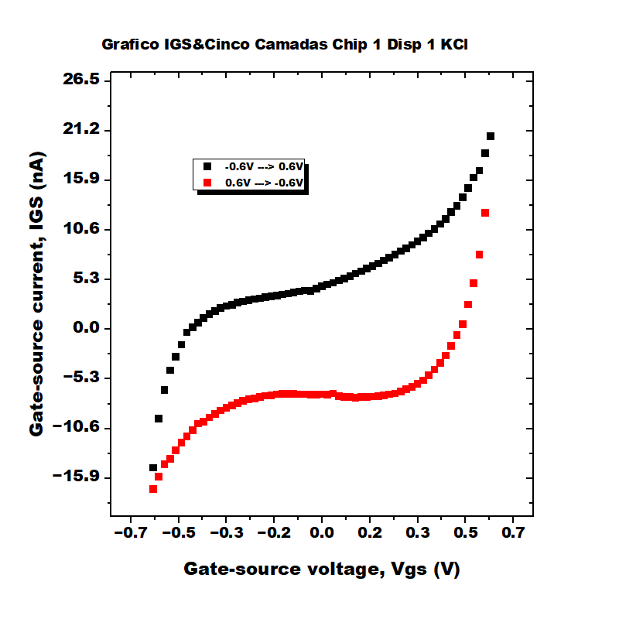
Cinco Camadas Chip 1 Disp 1 KCl

Slide 21
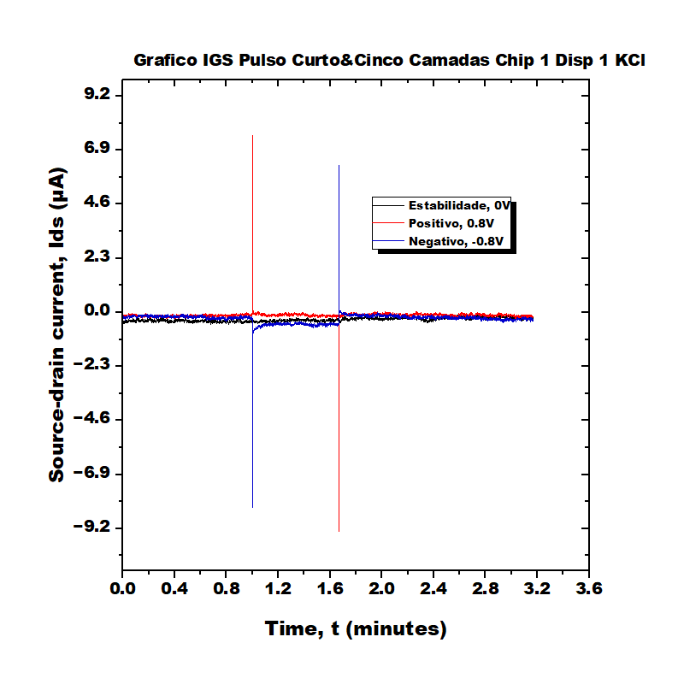




Cinco Camadas Chip 1 Disp 1 KCl

Slide 22

Cinco Camadas Chip 1 Disp 1 KCl

Slide 23



Cinco Camadas Chip 1 Disp 2 KCl

Slide 24





Cinco Camadas Chip 1 Disp 2 KCl

Slide 25

Cinco Camadas Chip 1 Disp 2 KCl

Slide 26



Cinco Camadas Chip 1 Disp 3 KCl

Slide 27





Cinco Camadas Chip 1 Disp 3 KCl

Slide 28

Cinco Camadas Chip 1 Disp 3 KCl

Slide 29



Enode Chip 1 Disp 1 MgCl2

Slide 30





Enode Chip 1 Disp 1 MgCl2

Slide 31

Enode Chip 1 Disp 1 MgCl2

Slide 32



Enode Chip 1 Disp 2 KCl

Slide 33





Enode Chip 1 Disp 2 KCl

Slide 34

Enode Chip 1 Disp 2 KCl

Slide 35



Enode Chip 1 Disp 3 KCl

Slide 36





Enode Chip 1 Disp 3 KCl

Slide 37

Enode Chip 1 Disp 3 KCl

Slide 38



Enode Chip 2 Disp 1 KCl

Slide 39





Enode Chip 2 Disp 1 KCl

Slide 40

Enode Chip 2 Disp 1 KCl

Slide 41



Enode Chip 2 Disp 2 MgCl2

Slide 42





Enode Chip 2 Disp 2 MgCl2

Slide 43

Enode Chip 2 Disp 2 MgCl2

Slide 44



Enode Chip 2 Disp 3 MgCl2

Slide 45





Enode Chip 2 Disp 3 MgCl2

Slide 46

Enode Chip 2 Disp 3 MgCl2

Slide 47



PoliDopamina Chip 1 Disp 1 KCl

Slide 48





PoliDopamina Chip 1 Disp 1 KCl

Slide 49

PoliDopamina Chip 1 Disp 1 KCl

Slide 50



PoliDopamina Chip 1 Disp 3 KCl

Slide 51





PoliDopamina Chip 1 Disp 3 KCl

Slide 52

PoliDopamina Chip 1 Disp 3 KCl

Slide 53



Quatro Camadas Chip 1 Disp 1 KCl

Slide 54





Quatro Camadas Chip 1 Disp 1 KCl

Slide 55

Quatro Camadas Chip 1 Disp 1 KCl

Slide 56



Quatro Camadas Chip 1 Disp 2 KCl

Slide 57





Quatro Camadas Chip 1 Disp 2 KCl

Slide 58

Quatro Camadas Chip 1 Disp 2 KCl

Slide 59



Quatro Camadas Chip 1 Disp 3 KCl

Slide 60





Quatro Camadas Chip 1 Disp 3 KCl

Slide 61

Quatro Camadas Chip 1 Disp 3 KCl

Slide 62



Standard Chip 1 Disp 1 KCl

Slide 63





Standard Chip 1 Disp 1 KCl

Slide 64

Standard Chip 1 Disp 1 KCl

Slide 65



Standard Chip 1 Disp 2 MgCl2

Slide 66





Standard Chip 1 Disp 2 MgCl2

Slide 67

Standard Chip 1 Disp 2 MgCl2

Slide 68



Standard Chip 1 Disp 3 MgCl2

Slide 69





Standard Chip 1 Disp 3 MgCl2

Slide 70

Standard Chip 1 Disp 3 MgCl2

Slide 71



Standard Chip 2 Disp 1 KCl

Slide 72





Standard Chip 2 Disp 1 KCl

Slide 73

Standard Chip 2 Disp 1 KCl

Slide 74



Standard Chip 2 Disp 2 MgCl2

Slide 75





Standard Chip 2 Disp 2 MgCl2

Slide 76

Standard Chip 2 Disp 2 MgCl2

Slide 77



Standard Chip 2 Disp 3 KCl

Slide 78





Standard Chip 2 Disp 3 KCl

Slide 79

Standard Chip 2 Disp 3 KCl

Slide 80



Standard Chip 5 Disp 1 H2ODI

Slide 81





Standard Chip 5 Disp 1 H2ODI

Slide 82
Standard Chip 5 Disp 1 H2ODI

Slide 83



Standard Chip 5 Disp 2 H2ODI

Slide 84





Standard Chip 5 Disp 2 H2ODI

Slide 85
Standard Chip 5 Disp 2 H2ODI

Slide 86



Standard Chip 5 Disp 3 H2ODI

Slide 87





Standard Chip 5 Disp 3 H2ODI

Slide 88
Standard Chip 5 Disp 3 H2ODI

Slide 89



Tricamada Chip 1 Disp 1 KCl

Slide 90





Tricamada Chip 1 Disp 1 KCl

Slide 91

Tricamada Chip 1 Disp 1 KCl

Slide 92



Tricamada Chip 1 Disp 2 KCl

Slide 93





Tricamada Chip 1 Disp 2 KCl

Slide 94

Tricamada Chip 1 Disp 2 KCl

Slide 95



Tricamada Chip 1 Disp 3 KCl

Slide 96





Tricamada Chip 1 Disp 3 KCl

Slide 97

Tricamada Chip 1 Disp 3 KCl

